Slide 1

Smart Datacenter
Daria Margherita Maggi
Internet of Things
A.Y. 2019-2020

Slide 2
Introduction
This project develops a temperature gap detection system, based on sensors and actuators installed in watchpoints all over a datacenter.
The devices interface with cloud application, that collects their data and offers to the user the possibility of switching the coolers installed all over the building not only automatically, but also manually.
Smart Datacenter 2

Slide 3
Structure
Each node has:
A temperature sensor capturing the registered local temperature
An actuator prompting the start or the stop of a local cooling system.
Moreover, the manual switching on of the cooler is suggested to the user if the detected gap between the last two registered temperatures is greater than 2 degrees.
Smart Datacenter 3

Slide 4
Structure
If the sensed temperature is higher than a hard-coded upper threshold, the system is switched ON if not already active. Likewise, if the system active and the sensed temperature is below a hard-coded lower threshold, the system is switched OFF.
As stated before, it can also be (de-)activated on user prompt for each node.

Slide 5
Cloud application
A CoAP server handles node registration & management through the Observer protocol.
The user can interact with the system through the command line interface.

Slide 6
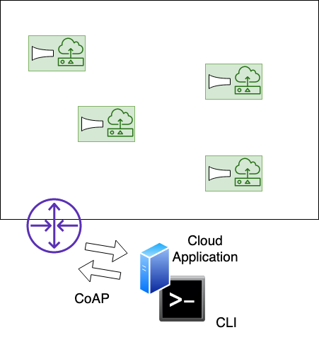
Ideal network

Slide 7
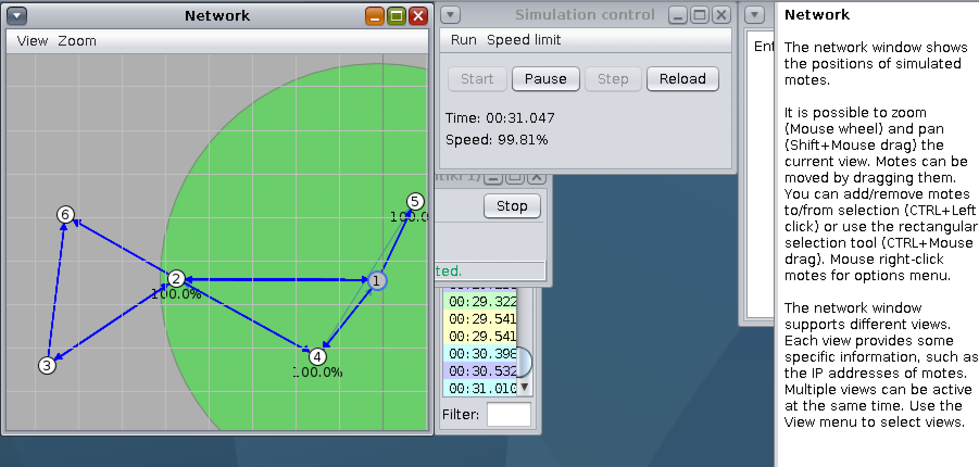
Simulated network
A screenshot of the simulation currently available. Speed limit has been set to 100% for readability purposes. Node 1 is the border router.

Slide 8
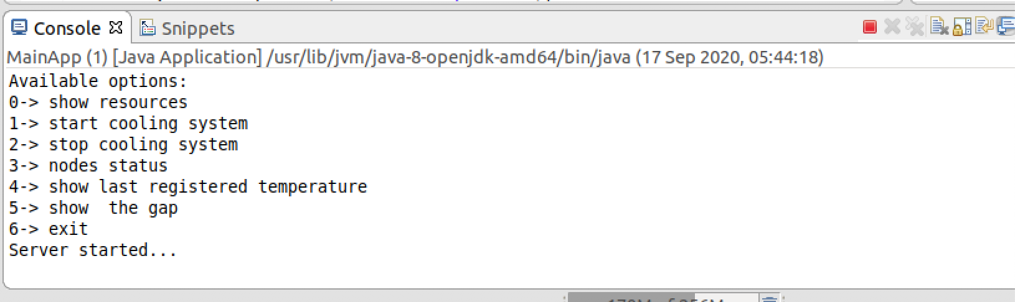
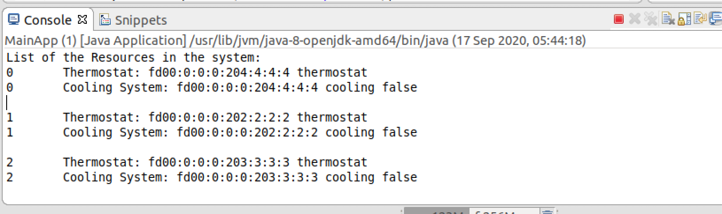
Command Line

